Slide 1

Quiz Answer Auto-grader
Problem statement:
Manual grading of short-answer quizzes is time-consuming and inconsistent. This project automates the grading process by comparing each student’s response with the model answer and generating a similarity score.
Team Name: Queue Crew
Members:
Ayushi Srivastava (PES1UG24CS105)
Bhoomika Dayanand Jituri (PES1UG25CS807)
Ashritha Kamalakar Hegde (PES1UG24CS089)
Pranav K (PES1UG25CS819)

Slide 2
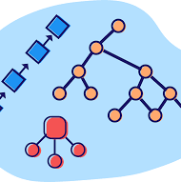
Data Structures Used
& Reason
Array
Stores list of questions and answers in sequence.
Simple sequential storage, easy traversal.
Hash Map
Maps each question to its model answer.
Provides quick lookup and prevents duplication.
Trie
Handles text similarity comparison efficiently.
Ideal for prefix-based string matching

Slide 3
ADT of HashMap
Abstract Data Type
HashMap <Key, Value>
Data
Key → Question (String)
Operations
insertHash(q, a): Insert question and answer pair.
Value → Model Answer (String)
searchHash(q): Retrieve model answer.
hashFunction(str): Generates hash index using ASCII-based computation.
Used for storing model answers for each question efficiently.
Ensures O(1) average time complexity with chaining for collision handling.

Slide 4
ADT of array & Trie (Prefix Tree)
Operations
insertTrie(root, word):
Adds a word to the Trie.
searchTrie(root, word):
Checks word presence.
matchScoreUsingTrie(modelAns, studAns):
Compares answers to generate similarity score.
Array(ADT):
Used for: Storing quiz questions and student responses sequentially.
Each Element Contains: Question ID and corresponding answer string.
Time Complexity: O(1) for access using index; O(n) for traversal and comparison.
Trie(ADT):
Each Node Contains
  26 children node pointers (a–z)
  Boolean flag: isEndOfWord
Efficient in prefix-based storage and searching

Slide 5
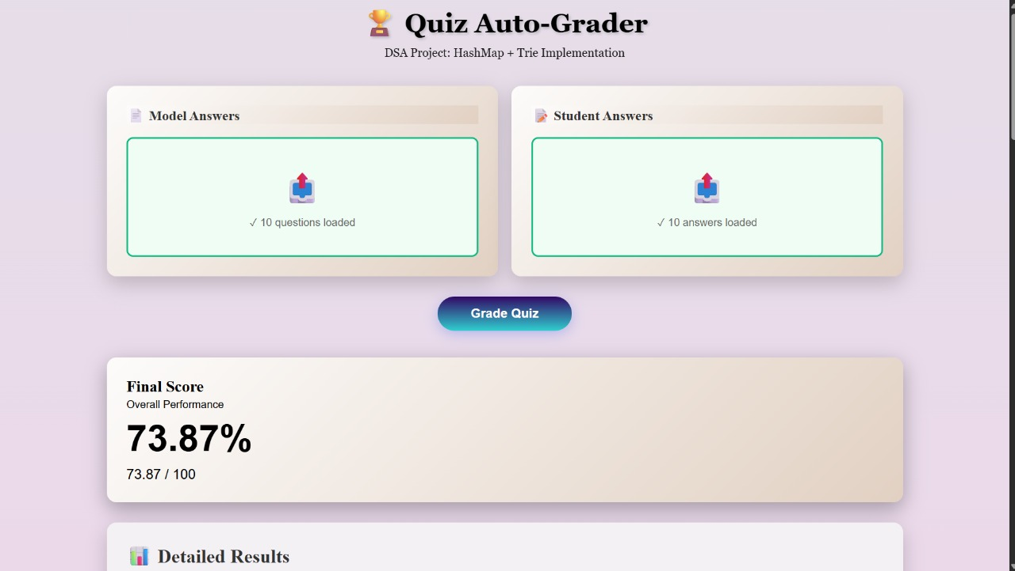
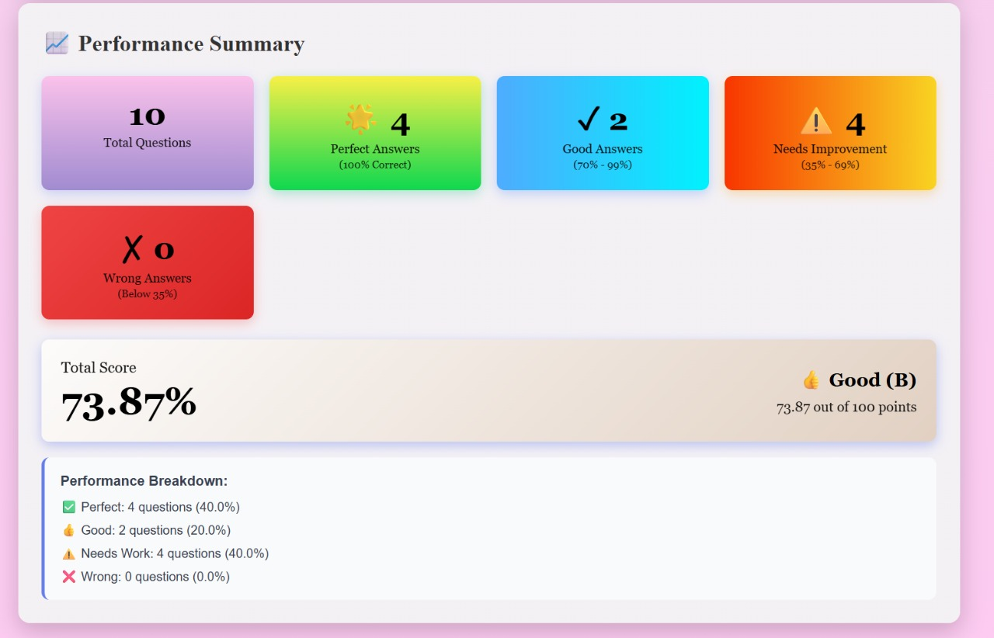
Input and Output Screenshots
Input Window
User Input Interface
Output Window
Auto-graded output window

Slide 6
Division of Work
Name | Contribution
Ayushi Srivastava | Core Logic & GUI
Bhoomika Dayanand Jituri | Hash Map Implementation
Ashritha Kamalakar Hegde | Trie Integration & Testing
Pranav K | Documentation & Presentation
Each member contributed significantly to design, coding, testing, and documentation.

Slide 7
Conclusion
The project successfully automates grading of short-answer quizzes using C language.
Combines Array, Hash Map, and Trie for high accuracy and speed.
Provides consistent evaluation.
GUI adds interactivity and ease of use.
Demonstrates practical use of data structures in real-world systems
Future Scope: Future improvement: integrate ML for semantic grading.”)
Motive: Automating Education – One quiz at a time..

Slide 8

Thank you
FROM TEAM Queue Crew

